Slide 1
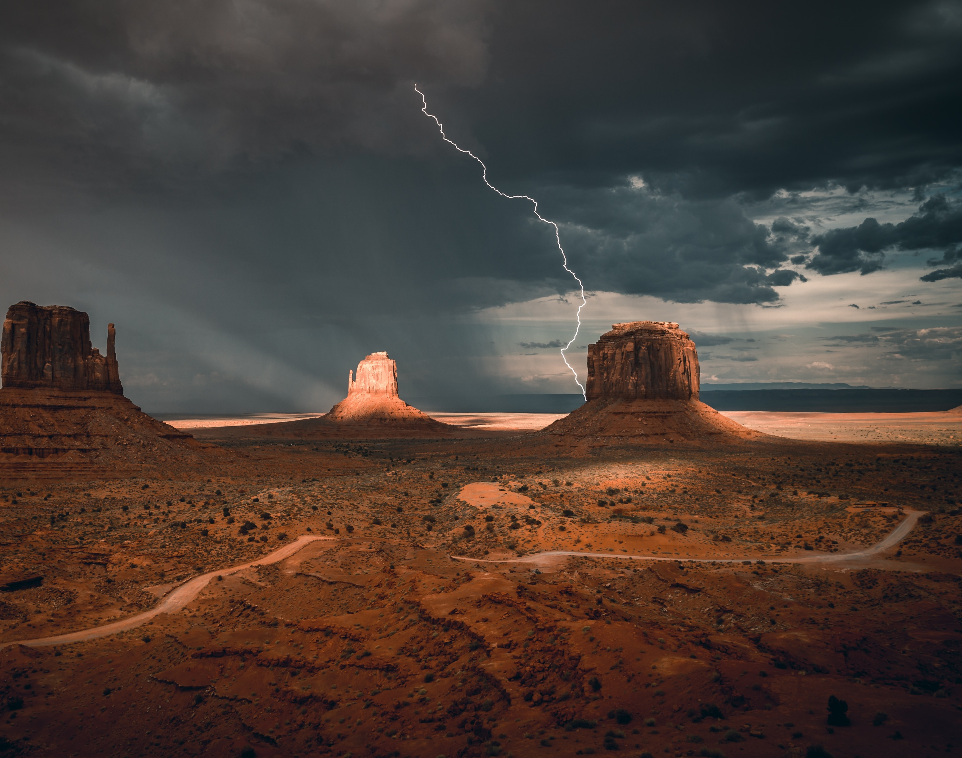
RAPTURE AND WRATH
Revelation 8:6-13

Slide 2
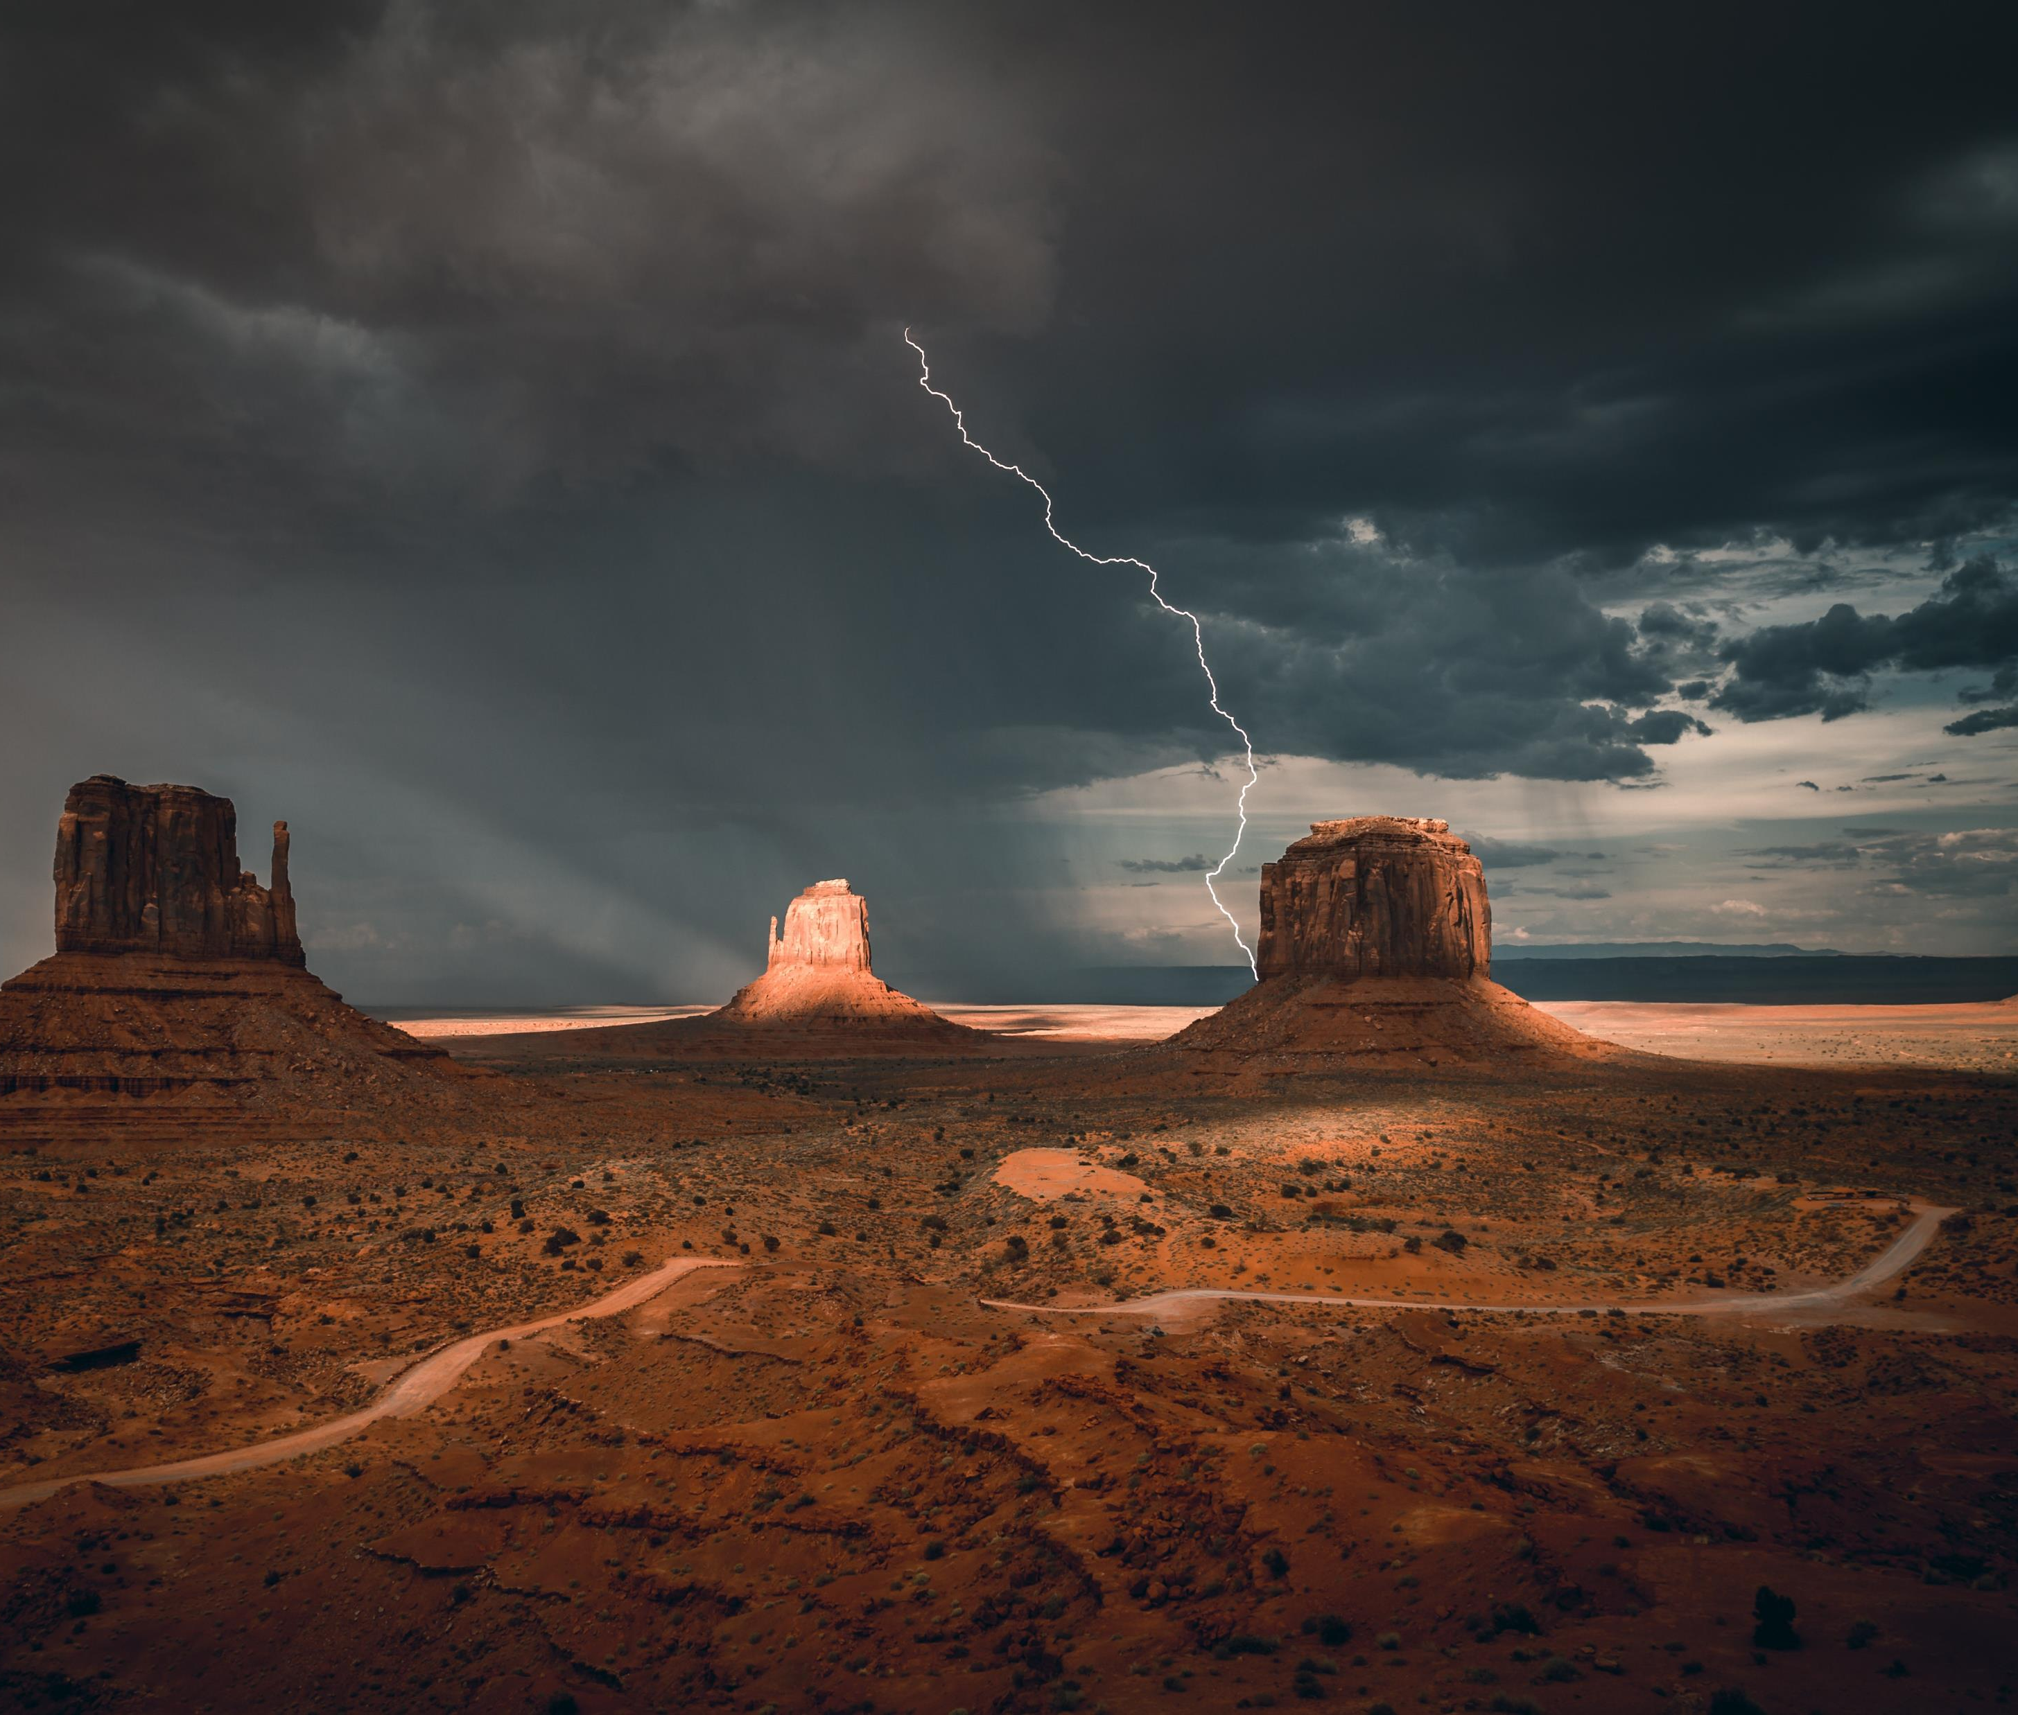
RAPTURE AND WRATH
The first trumpet – LAND (8:7)

Slide 3
RAPTURE AND WRATH
The first trumpet – LAND (8:7)
The second trumpet – SEA (8:8-9)

Slide 4
RAPTURE AND WRATH
The first trumpet – LAND (8:7)
The second trumpet – SEA (8:8-9)
The third trumpet – RIVERS (8:10-11)

Slide 5
RAPTURE AND WRATH
The first trumpet – LAND (8:7)
The second trumpet – SEA (8:8-9)
The third trumpet – RIVERS (8:10-11)
The fourth trumpet – SKY (8:12-13)

