Slide 1
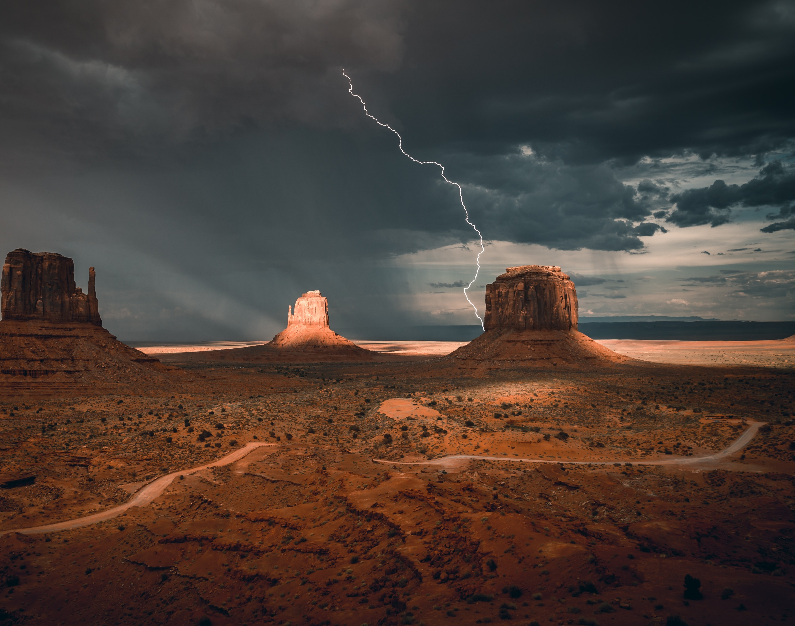
The Seventh Seal & Saintly Supplications
Revelation 8:1-5

Slide 2
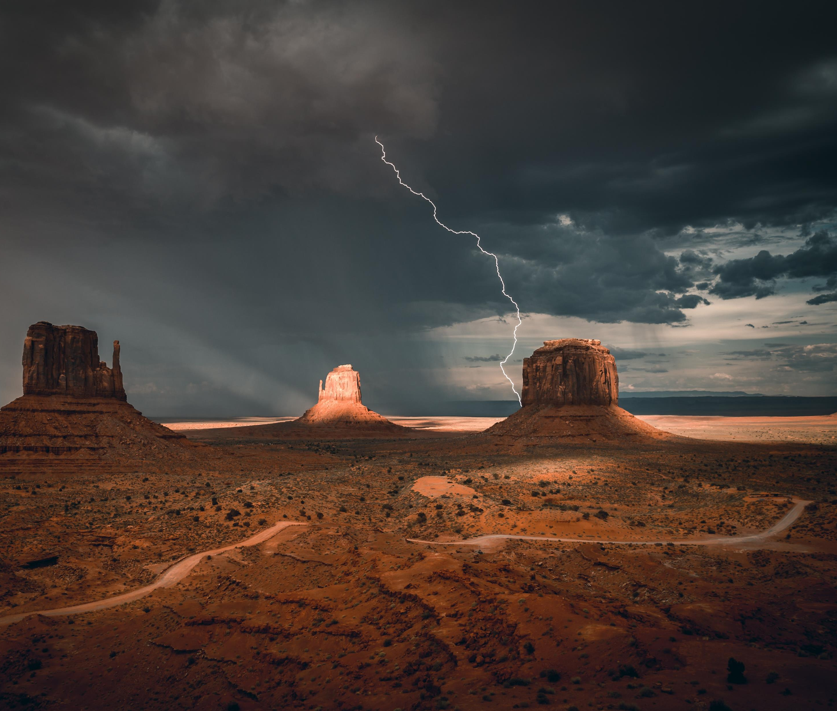
The Seventh Seal & Saintly Supplications
The SILENCE! – verse 1

Slide 3
The Seventh Seal & Saintly Supplications
The SILENCE! – verse 1
The SOUNDING! – verse 2

Slide 4
The Seventh Seal & Saintly Supplications
The SILENCE! – verse 1
The SOUNDING! – verse 2
The SUPPLICATIONS! – verse 3-4

Slide 5
The Seventh Seal & Saintly Supplications
The SILENCE! – verse 1
The SOUNDING! – verse 2
The SUPPLICATIONS! – verse 3-4
The STORM! – verse 5

