Slide 1
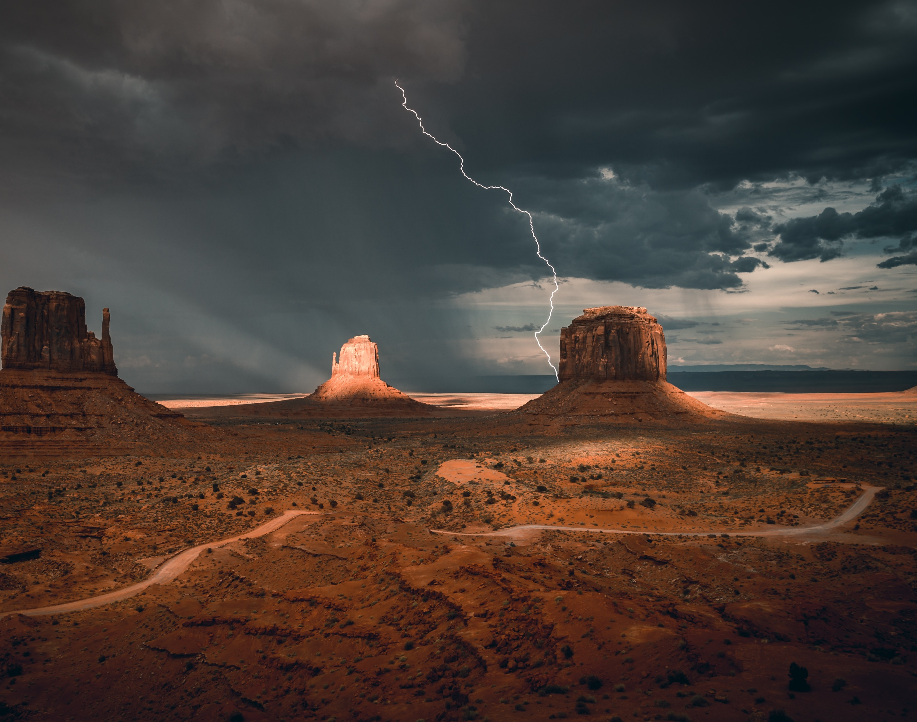
SWEET AND SOUR – PART 2
Revelation 10:5-7

Slide 2
Daniel 9:1-3
In the first year of Darius, the son of Ahasuerus, a Mede by birth, who was made king over the Chaldean kingdom— in the first year of his reign, I, Daniel, understood from the books according to the word of the LORD to the prophet Jeremiah that the number of years for the desolation of Jerusalem would be seventy. So I turned my attention to the Lord God to seek him by prayer and petitions, with fasting, sackcloth, and ashes.

Slide 3
Daniel 9:20-23
While I was speaking, praying, confessing my sin and the sin of my people Israel, and presenting my petition before the LORD my God concerning the holy mountain of my God— while I was praying, Gabriel, the man I had seen in the first vision, reached me in my extreme weariness, about the time of the evening offering. He gave me this explanation: “Daniel, I’ve come now to give you understanding. At the beginning of your petitions an answer went out, and I have come to give it, for you are treasured by God. So consider the message and understand the vision:

Slide 4
Daniel 9:24
Seventy weeks are decreed
about your people and your holy city—
to bring the rebellion to an end,
to put a stop to sin,
to atone for iniquity,
to bring in everlasting righteousness,
to seal up vision and prophecy,
and to anoint the most holy place.

Slide 7
Daniel 9:25
Know and understand this:
From the issuing of the decree
to restore and rebuild Jerusalem
until an Anointed One, the ruler,
will be seven weeks and sixty-two weeks.
It will be rebuilt with a plaza and a moat,
but in difficult times.

Slide 10
COMMAND GIVEN TO EZRA
In 457 BC, Artaxerxes, king of Persia, issued a decree for Ezra to rebuild the city

Slide 15
Daniel 9:25
Know and understand this:
From the issuing of the decree
to restore and rebuild Jerusalem
until an Anointed One, the ruler,
will be seven weeks and sixty-two weeks.
It will be rebuilt with a plaza and a moat,
but in difficult times.

Slide 18
Daniel 9:26
After those sixty-two weeks
the Anointed One will be cut off
and will have nothing.
The people of the coming ruler
will destroy the city and the sanctuary.
The end will come with a flood,
and until the end there will be war;
desolations are decreed.

