Slide 1
PREMILLENNIALISM
Hermeneutics and History

Slide 2
PREMILLENNIALISM
Hermeneutics and History
The same hermeneutic that makes us Calvinists and Reformed in our salvation makes us Premillennialists

Slide 3
PREMILLENNIALISM
Hermeneutics and History
“we must frankly admit that a literal interpretation of the Old Testament prophecies gives us just such a picture of an earthly reign of the Messiah as the premillennialist pictures.”
- Floyd Hamilton (critic of premillennialism)

Slide 4
PREMILLENNIALISM
Hermeneutics and History
Postmillennialist Loraine Boettner concurred, stating, “It is generally agreed that if the prophecies are to be taken literally, they do foretell a restoration of the nation of Israel in the land of Palestine with the Jews having a prominent place in that kingdom and ruling over the other nations.”

Slide 5
PREMILLENNIALISM
Hermeneutics and History
Nineteenth-century Presbyterian pastor E. R. Craven sums this up well: The Literalist (so called) is not one who denies that figurative language, that symbols, are used in prophecy, nor does he deny that great spiritual truths are set forth therein; his position is, simply, that the prophecies are to be normally interpreted (i.e., according to the received laws of language) as any other utterances are interpreted—that is manifestly literal being regarded as literal, that which is manifestly figurative being so regarded

Slide 6
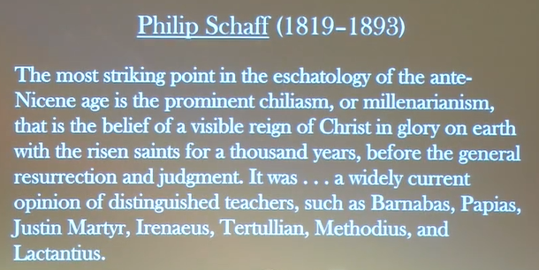

Slide 7
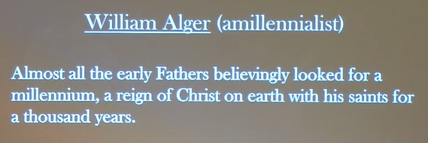

Slide 8
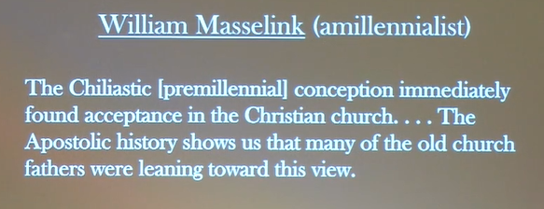

Slide 9
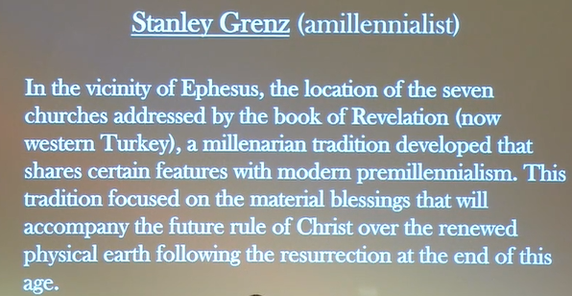

Slide 10
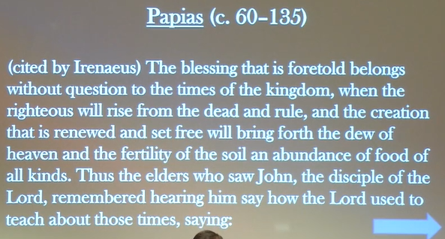

Slide 11
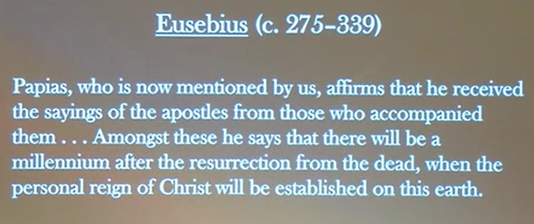

Slide 12
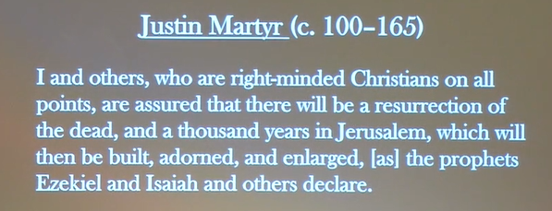

Slide 13
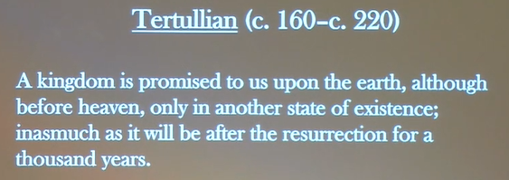

Slide 14
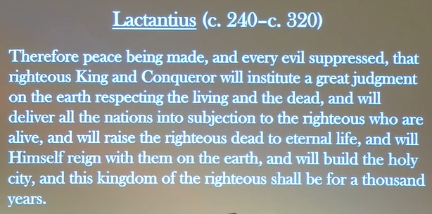

Slide 15
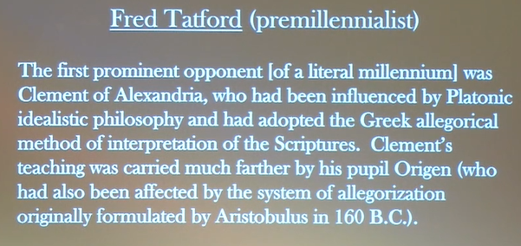

Slide 16
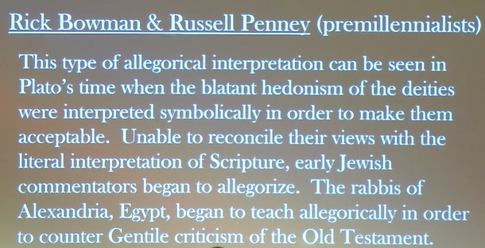

Slide 17
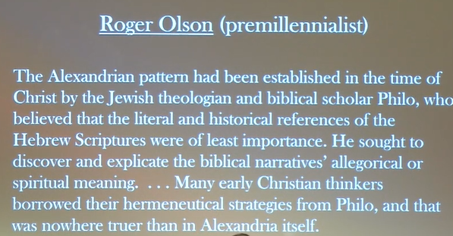

Slide 18
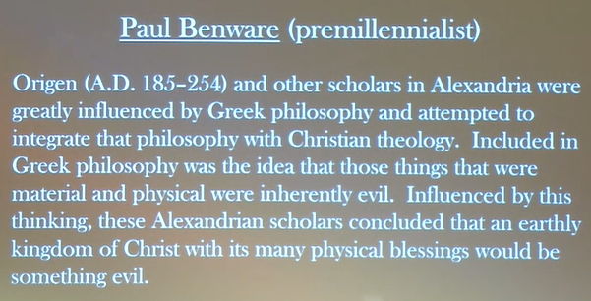

Slide 19
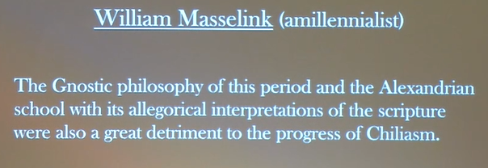

Slide 20
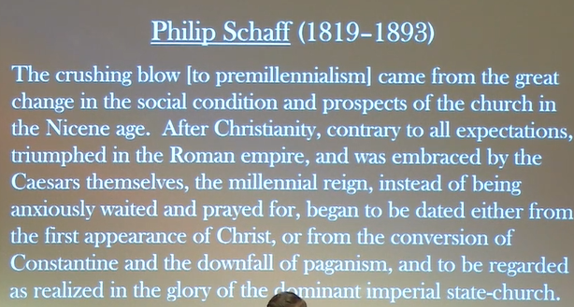

Slide 21
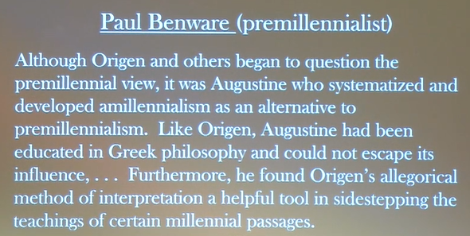

Slide 22
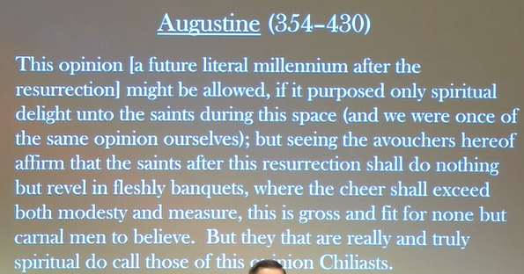

Slide 23
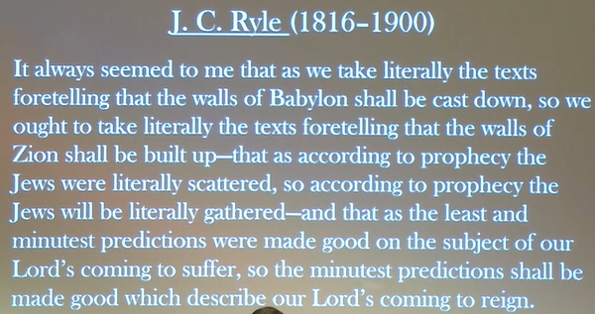

Slide 24
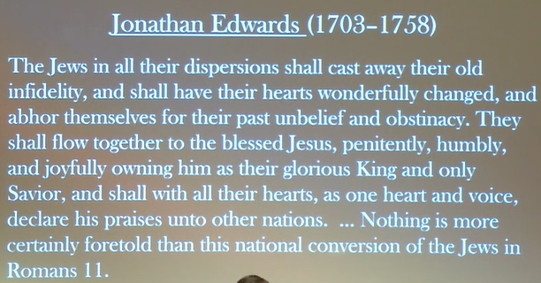

Slide 25
